Slide 1
Module 3-IND ENG 243
Presented by- Anmol, Ankit, Aakash, Serah, Raushan & Sonia

Slide 2
Let’s Recap
Objectives-
Identify the key origin and destination spots in the city where there’s high demand for cabs.
Satisfy this demand by setting up hubs and shuttle service serving these most popular routes.
In the process provide an alternative to public transport which is more reliable and more cost effective than hiring full cab for oneself.
Reduce traffic congestion and carbon emissions by aggregating several requests and satisfying it by utilizing one vehicle.

Slide 3

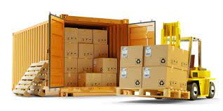
Inspired by logistics and shipping industry

Slide 4
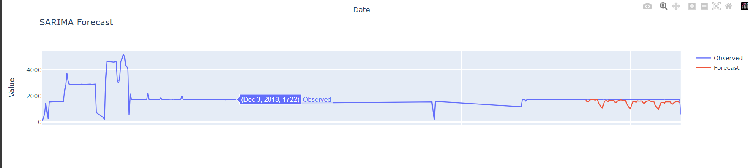

Interactive Graph To See Demand Forecast

Slide 5


Slide 6
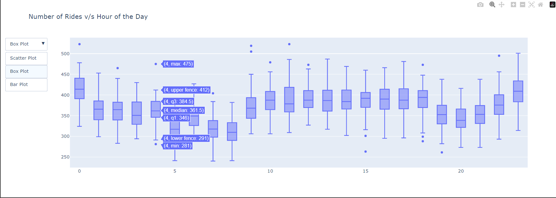
Graph to see Demand Forecast

Slide 8
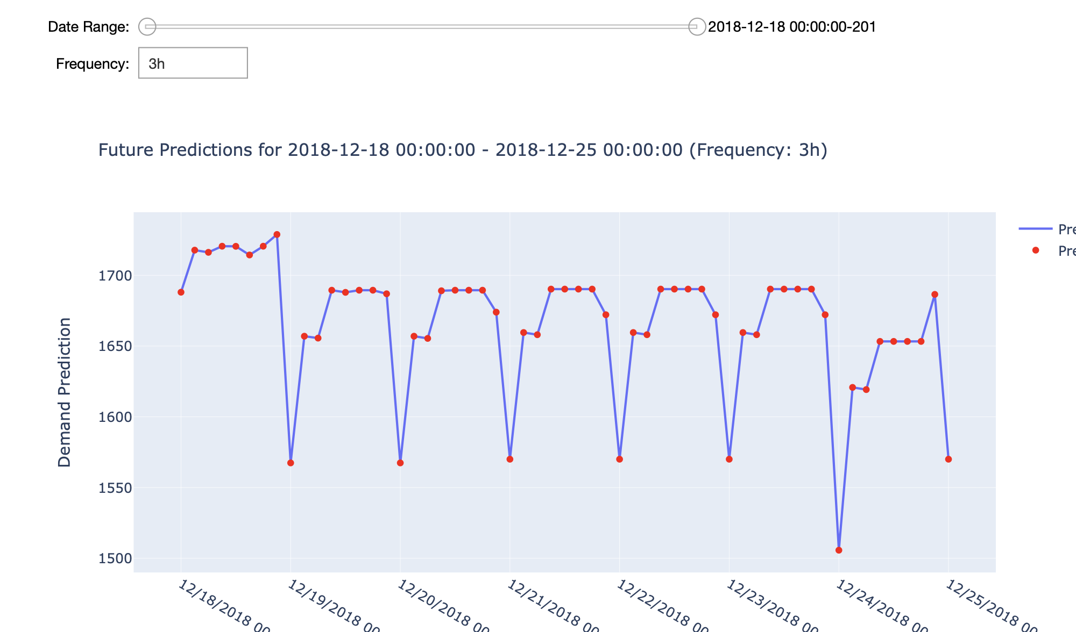
Interactive graph for future demand prediction

Slide 10
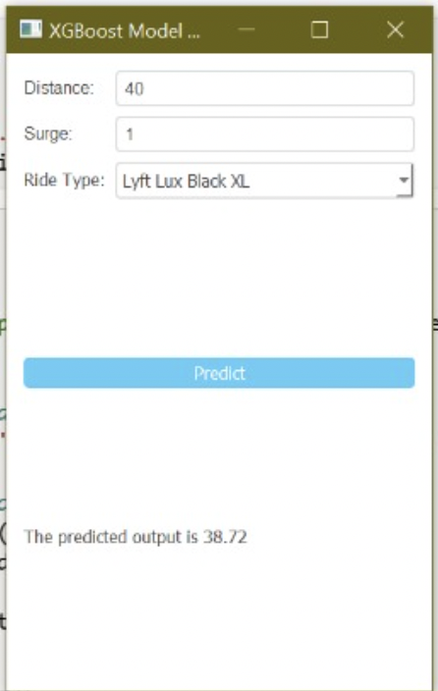
Interactive Predictor for Price
In Module 2, we used Linear Regression, Decision tree regressor, Random forest regressor, and XG BOOST to predict fare price.
Input:
Distance
Surge Multiplier
Ride Type
Output: Predicted Price
(with 96% accuracy)

Slide 11
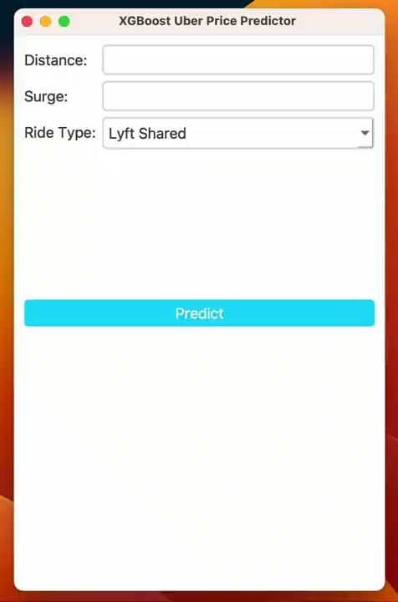

Slide 12
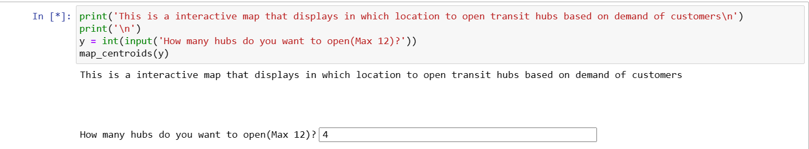
Interactive Maps:
In the previous module we showed how we can use the folium library and KMeans clustering in order to identify where to open hubs based on demand. The results are shown below:

Slide 13
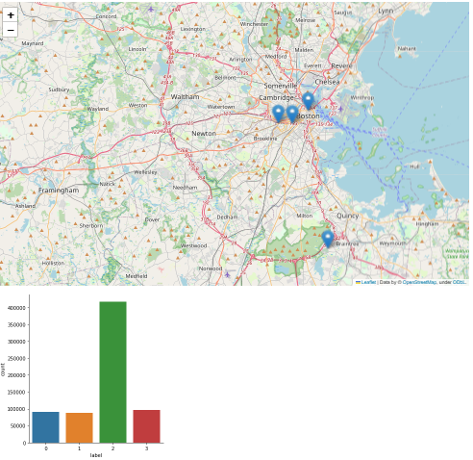
Results:
The end result is a map that displays
Where to open the transit hubs and
A graph that displays the demand at each
Of these hubs. This allows the person
Using this to make a informed decision
On how many hubs to open and where.

Slide 14
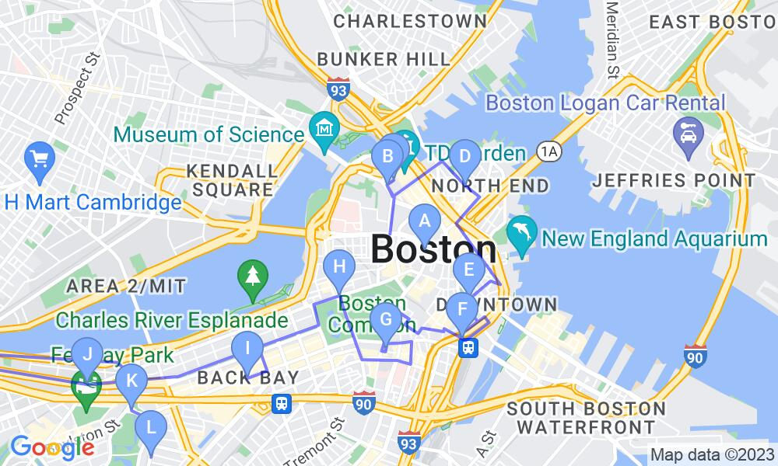
When k=12

Slide 15
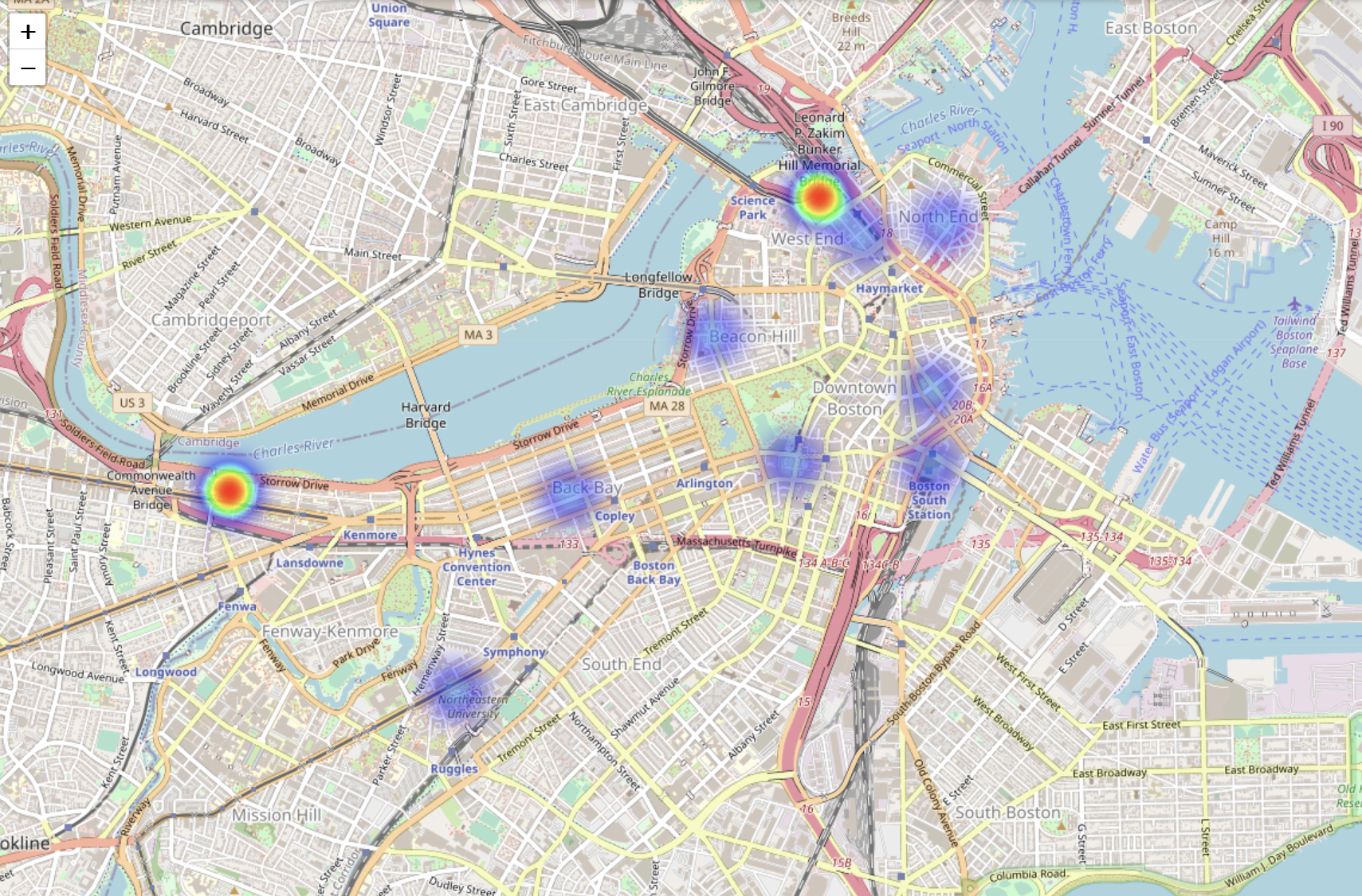
If we keep hubs to ~12, we see similar hub positions to those when we create a Heatmap generated using the data.

Slide 16
Using Hubs to Create Routes
Input both the source and destination addresses from user
Addresses can be in natural language/ coordinates/ zip code
We present a route for the user from source to destination such that he/she passes through the 2 nearest given transit hubs.

Slide 17
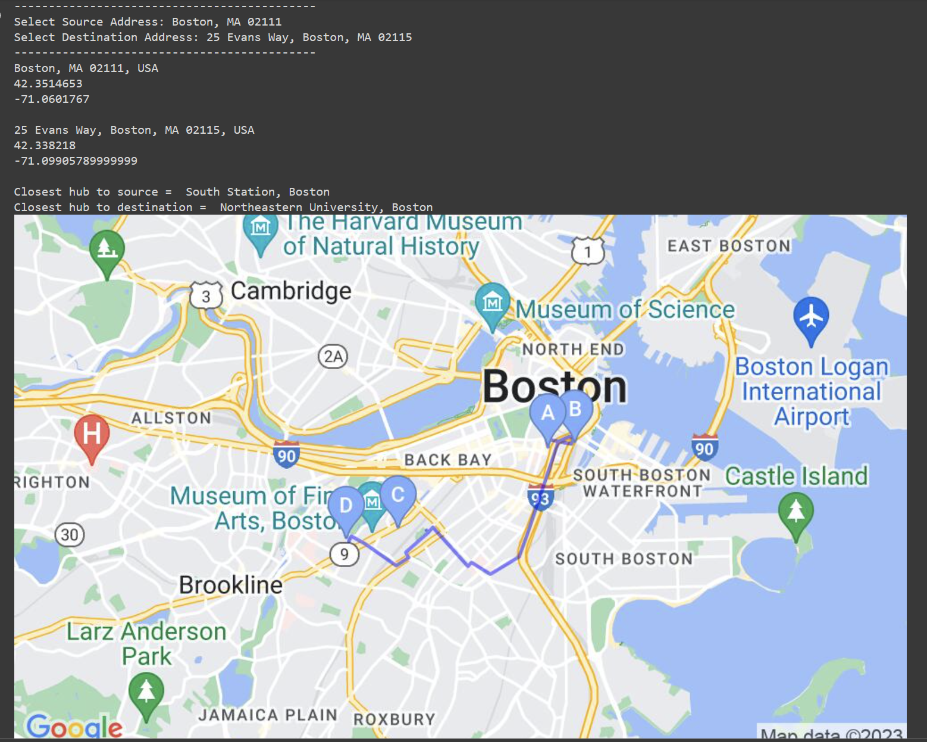

Slide 18
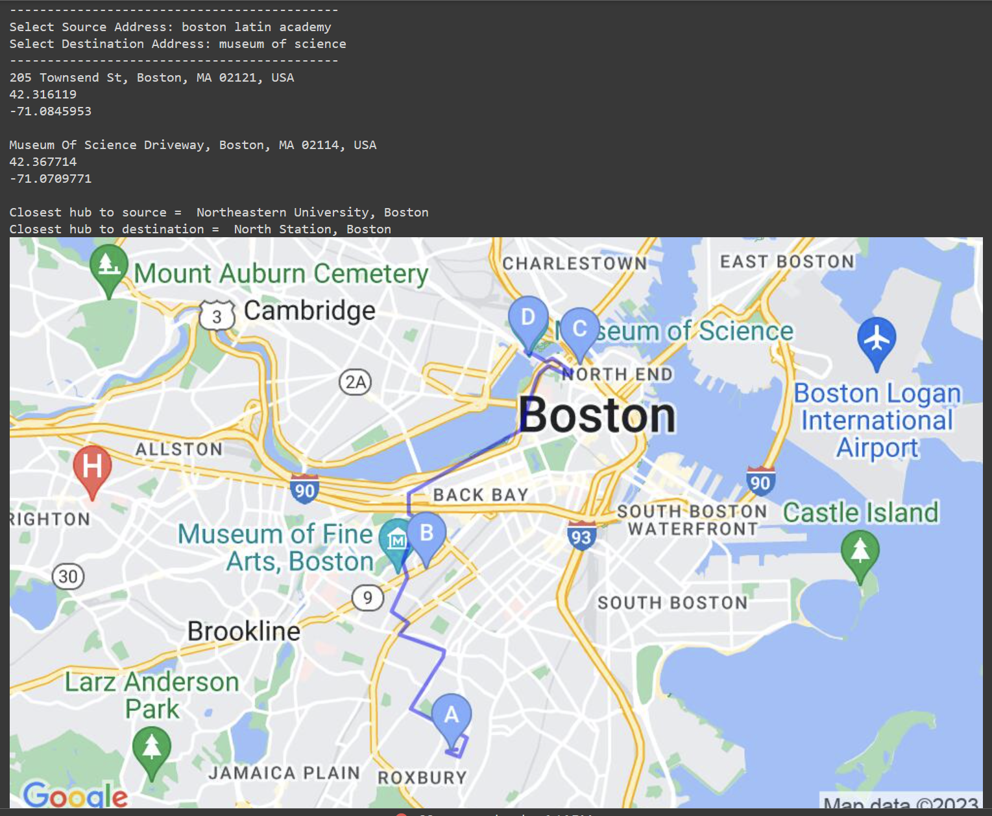

Slide 19
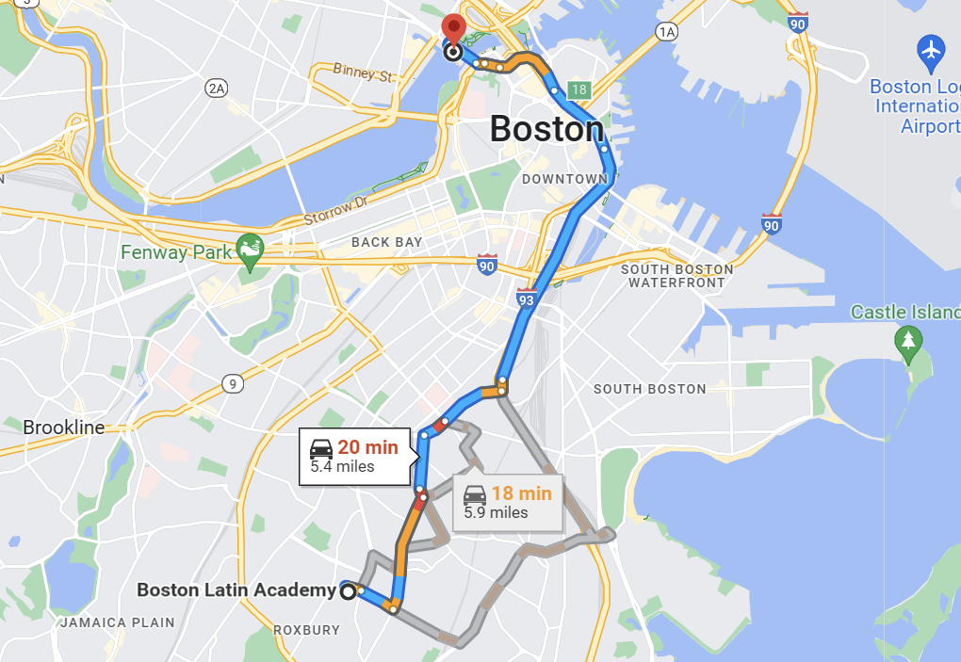
This is the route planned by Google maps

Slide 20


